Slide 1
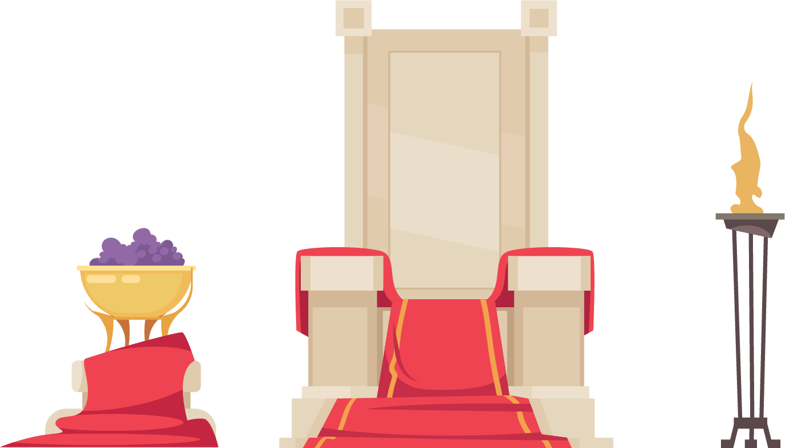
WaRRior’s reckoning
SP4 done by: Winston, Jun Ying, Luke, Ethan

Slide 2
Table of Contents
01
02
Game Concept
Features
03
04
Extra Details
contribution

Slide 3

01
Game
Concept

Slide 4

Wave Based Combat
The player survives against multiple waves of enemies while killing them.
The player progresses through the arenas in order to earn their freedom.

Slide 5
Scene Flow
Arena
Repeat
Wave based combat in different levels
Death resets the game before a new wave of combat
HUB
Graveyard
Spawn point and training locations
A collection of past deaths and accomplishments

Slide 6
02
Features

Slide 7

features
Wave-based Combat
Enemy types
Variety Of Weapons
Unique Maps
Survival aspects based on numerous enemies swarming the player
Enemies with different weapons offer varying threats for the player
Traditional weapons to allow for many playstyles
Each arena has its own features and hazards that changes how the player plays the game

Slide 8
03
Extra Details

Slide 9
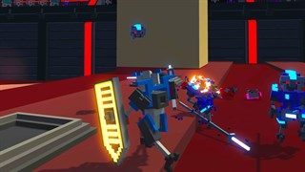
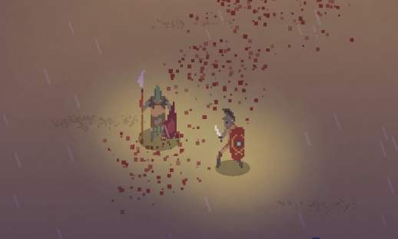

Influences and Inspirations
Clone Drone in the Danger zone
Gladium
3rd person fighting game where the player controls a robot to fight a variety of other robots, with different weapons
A 2D top down game about gladiators earning money and prestige through wave based combat

Slide 10
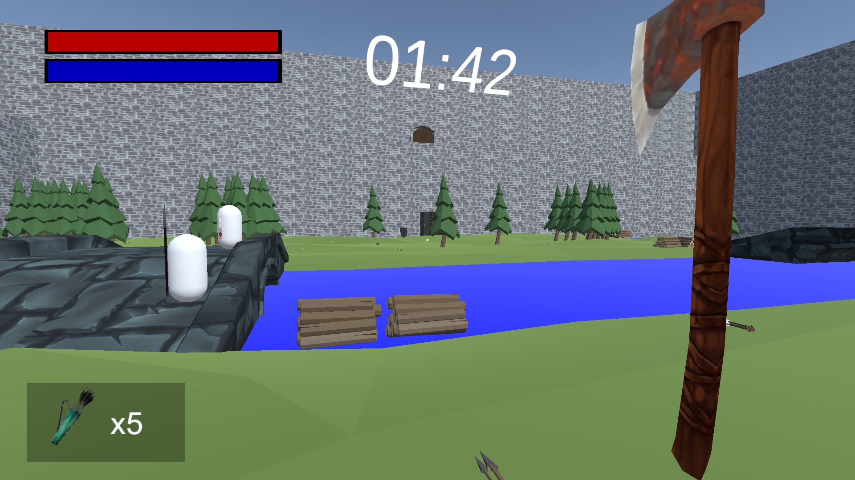
Video Trailer

Slide 11
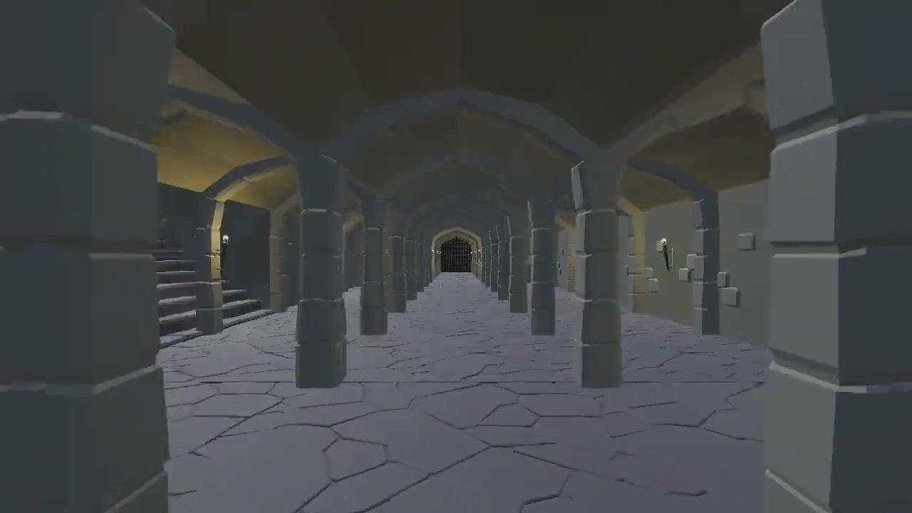

Slide 12
Contribution
Arena Flow
Timer/Waves
Enemy Spawning
Player Feedback
Floating damage text
UI directional Indicators
Base NPC
Health
FSM
Extended Combat
Velocity Based Damage
Projectiles, throwing weapons
Map design
Forest
Volcano
Traps
Spikes
Fire Spout

Slide 13
Contribution
Jun Ying:
AI
Basic AI (Basic Movement, Attacking)
Complex AI (Retreating, Flanking etc)
Navigation (Pathfinding)
Map Design
Hub
Forest
Desert
Volcano
Castle

Slide 14
Contribution
Luke:
Weapons
Weapon attack
Weapon Animations
Weapon stats
Interaction
Picking up interactables
Weapon swapping
Dropping weapons
Environment hazards
Water/Quicksand/Lava
Settings
UI on/off

Slide 15
Contribution
Ethan:
Player Controller
Movement
Camera effects
UI
Changing Scenes
Enemy death effects
Menu and Screens
Name input
Settings (audio sliders)
Graveyard
History
Training Room
Dummy

Slide 16
Task Contribution
Winston | Concept Slides GDD TDD | Global Time Arena flow Progression Enemy Spawners | Player Feedback Damage text UI indicators | Combat Base Weapons Projectiles | NPCs Base Health Base AI Navigation | Map Design Forest Volcano | Traps Spikes Fire spout
Luke | Concept Slides GDD TDD | Weapons Types Animations Balancing | Weapon Interaction | Environmental Hazards Water Lava Quicksand | Settings Shared preferences
Jun Ying | Concept Slides GDD TDD | Map Design Hub Forest Desert Volcano Castle | Audio SFX BGM | NPCs Base AI Navigation Complex Behaviour
Ethan | Concept Slides GDD TDD | Player UI Movement | Gravestone Player stats History | Screenflow Menu Settings | Polishing NPC death effects | Training room Weapons Training dummy

